Slide 1

Cryptarithmetic
A mathematical puzzle-Digits replaced by alphabets

Slide 2
Learning Objectives
Word Addition
Verbal Arithmetic
Problem Solving Skill

Slide 3
Cryptarithmetic: Rules
Each letter represents only one digit through out the question and is unique.
Starting letter value cannot be zero.
The question will have one and only one solution.
Apply the basic principles of arithmetic operations.
After decrypt, finally verify the result.

Slide 4
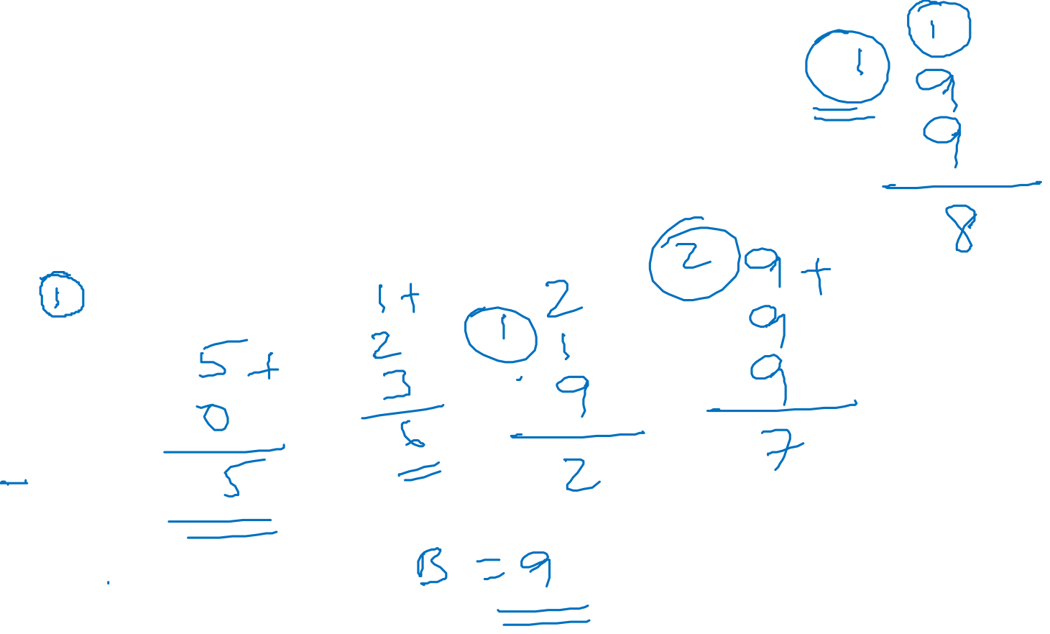
Cryptarithmetic: Tips
The max carry is 1 for 2 single digit sum,
2 for 3 single digit sum & so on.
If A +
B
A
B = 0 (no carry)
B = 9 (As 1 carry from the previous step)

Slide 5
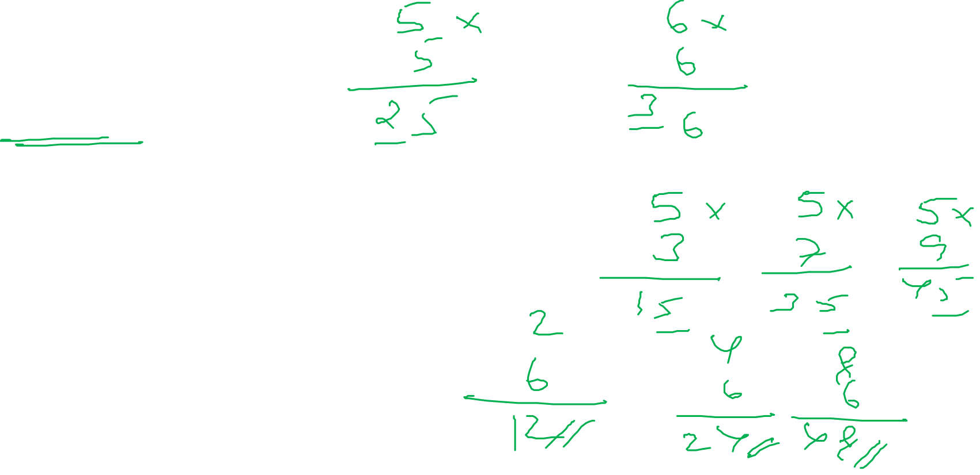
Cryptarithmetic: Tips
A ×
A
__A
A= 5 or 6.
A ×
B
__A then possible values of A and B,
A = 5 and B = 3, 7, 9.
A = 2, 4, 8 and B = 6.

Slide 6
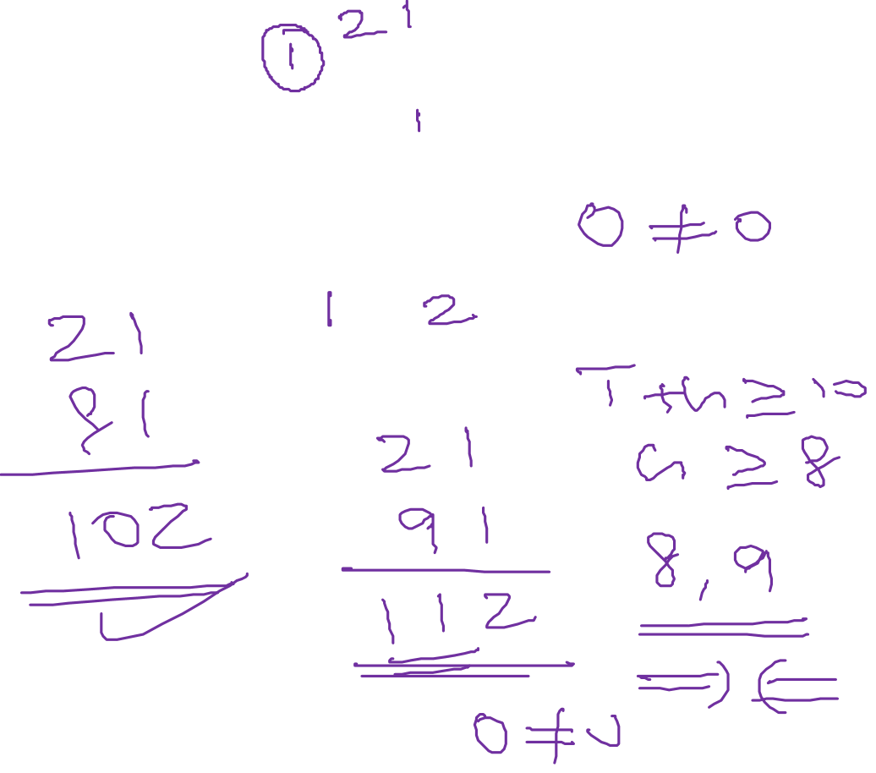
Problem 1
Ans: 21+81=102
T O +
G O
O U T

Slide 7
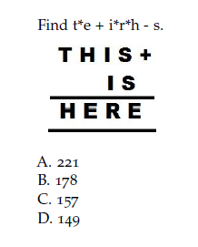
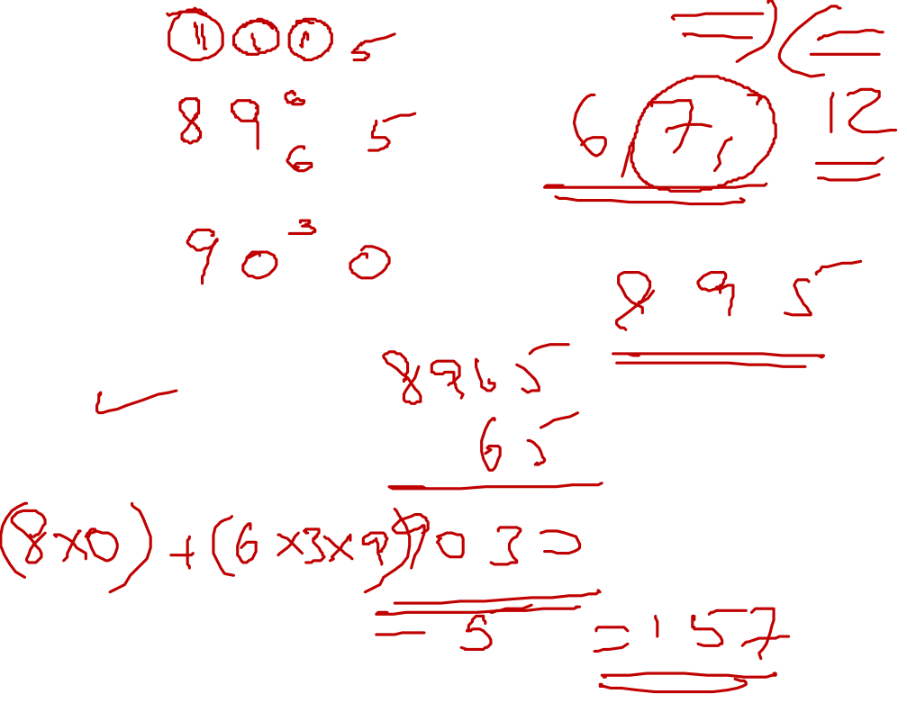
Problem 2
Option C
Option C
Option C

Slide 8
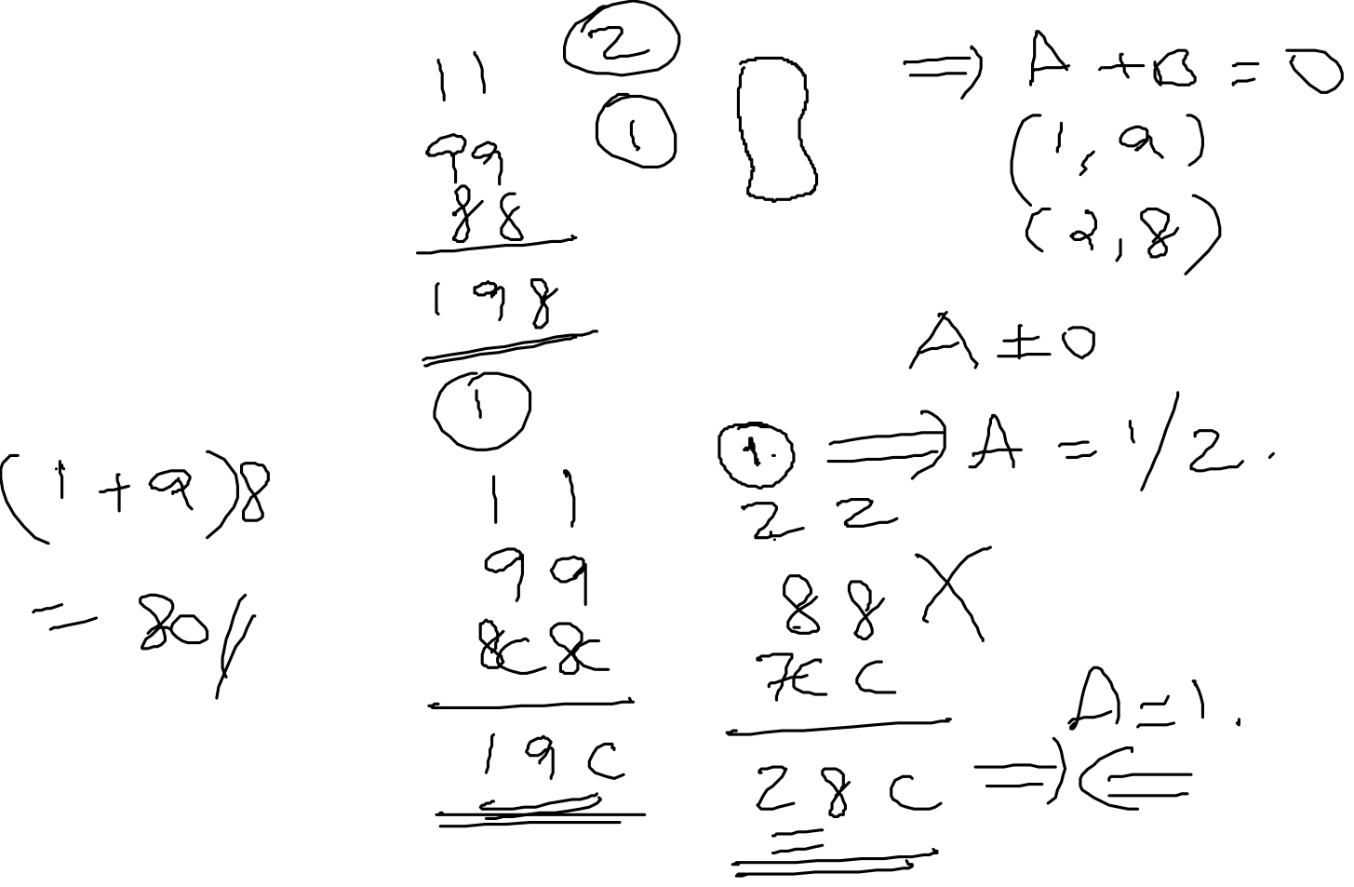
Problem 3 Find (A+B)C ?
A A +
B B
C C
A B C
Ans: 80

Slide 9
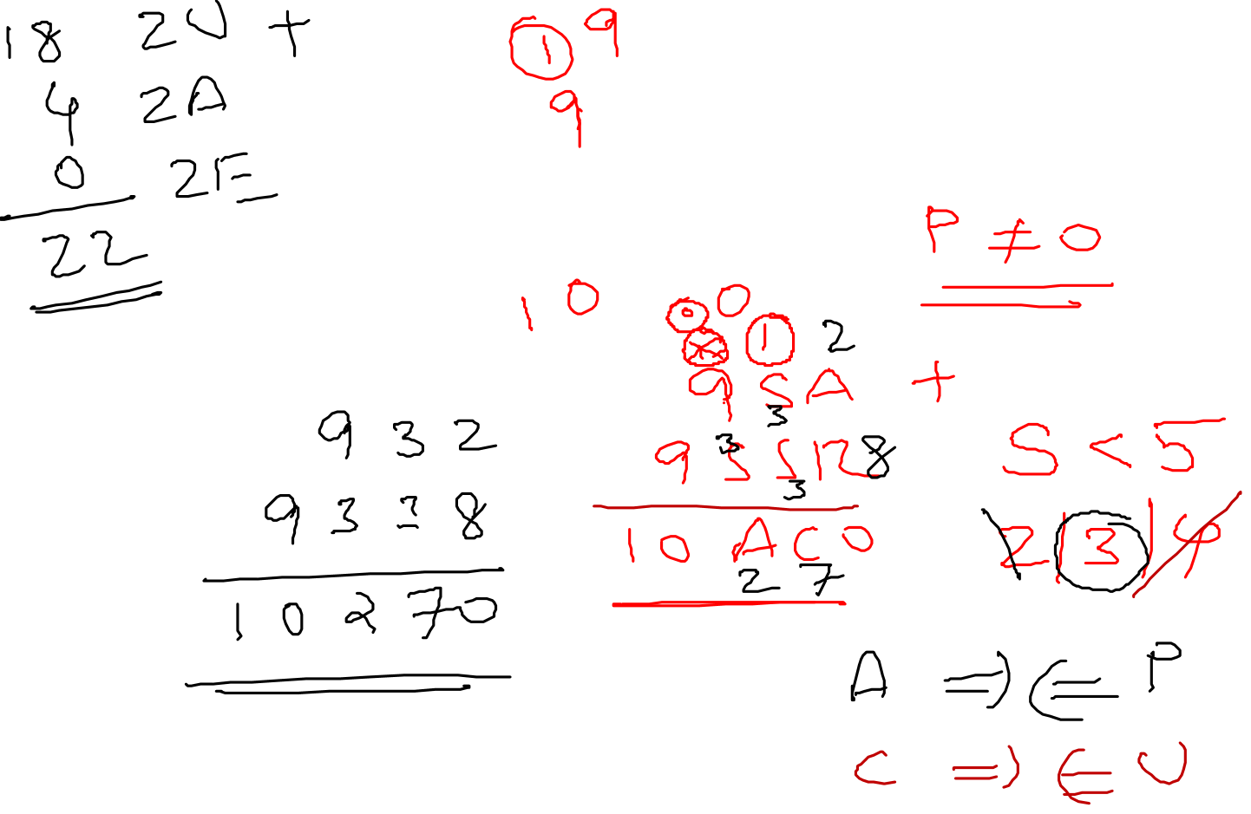
Problem 4 Find the sum of the vowels?
Ans: 22
U S A +
U S S R
P E A C E

Slide 10
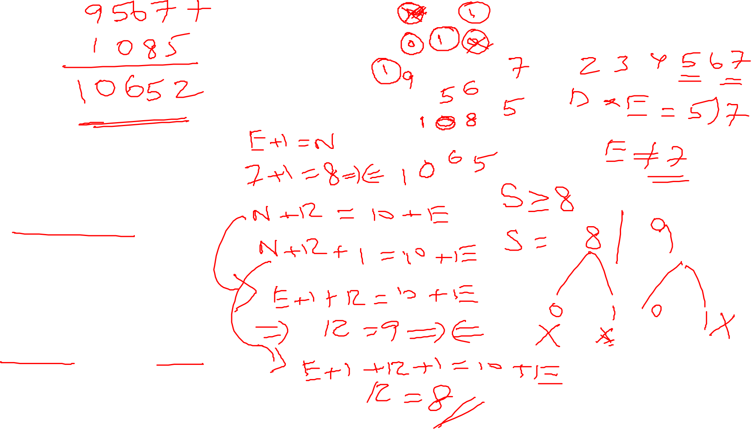
Problem 5 Decrypt MONEY ? Henry Ernest Dudeney-1924
S E N D+
M O R E
M O N E Y
Ans: 10652

Slide 11
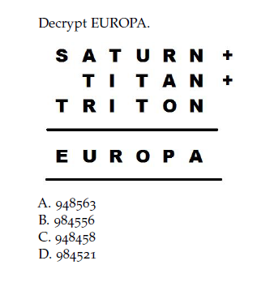
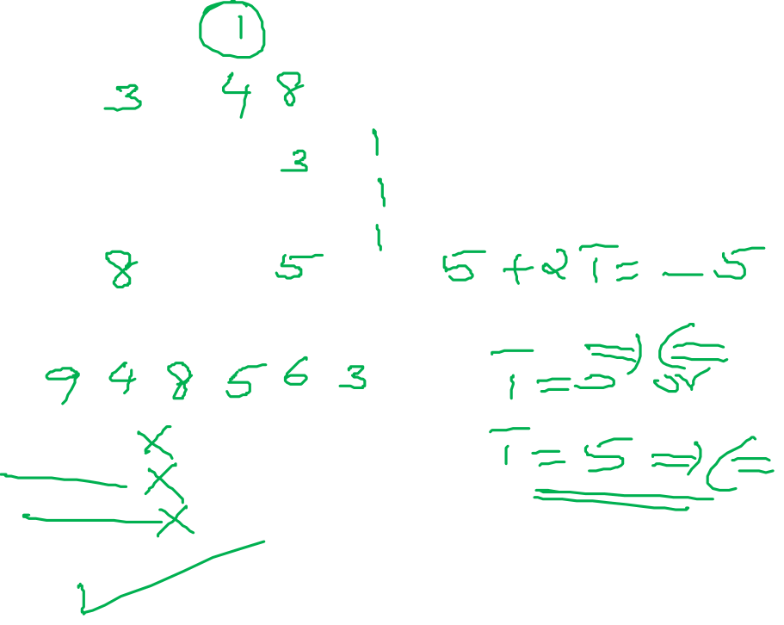
Problem 6
Option D
Option C
Option C

Slide 12

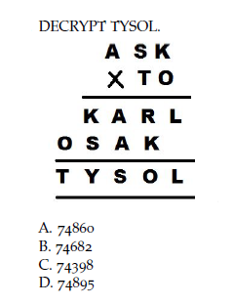
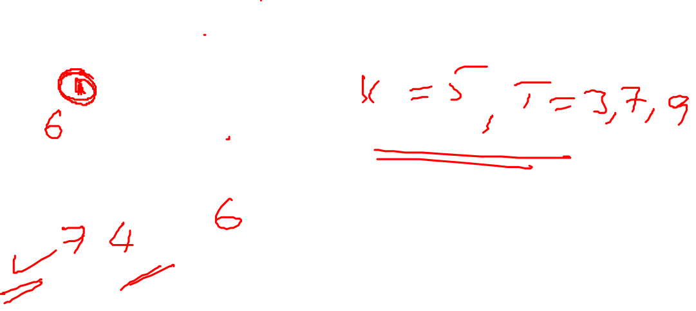
Problem 7
Option A

Slide 13
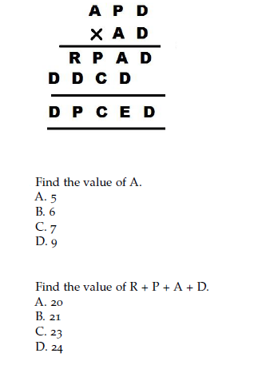
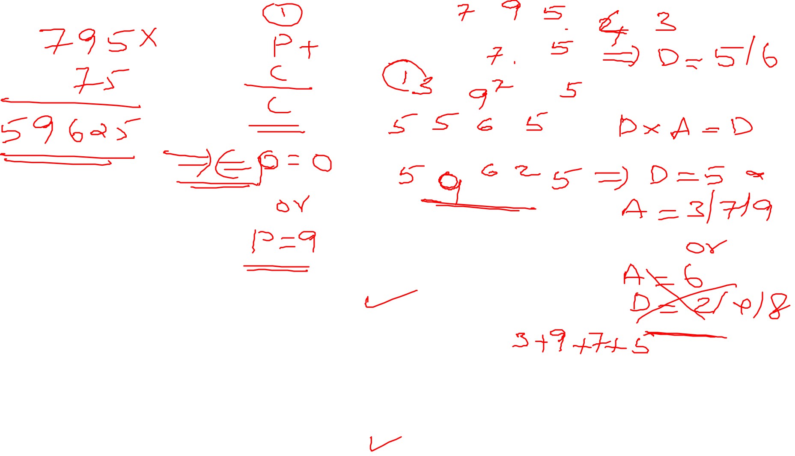
Problem 8
Option C & D

Slide 14
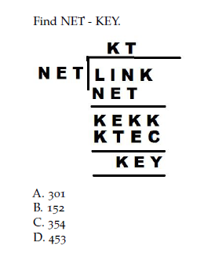
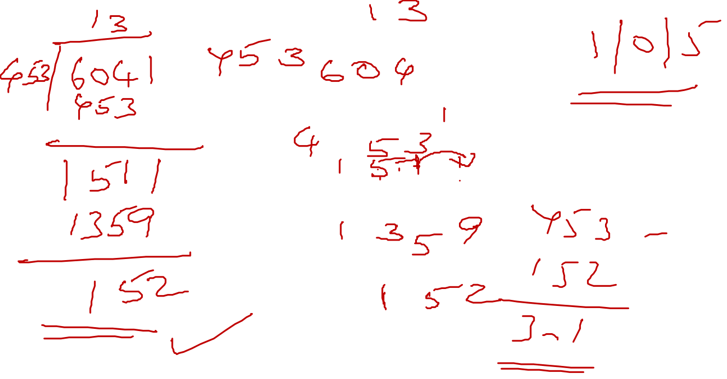
Problem 9
Option A

Slide 15
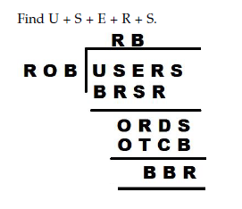
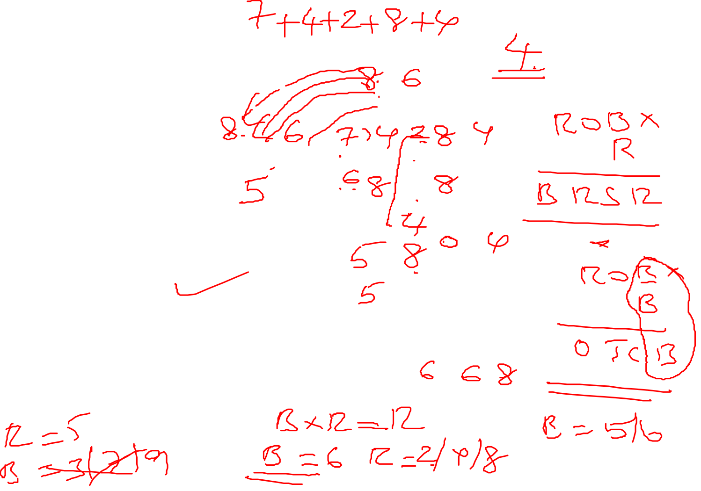
Problem 10
25
31
18
24
Option A

Slide 16


Thank you Narayanan RS

